Slide 1
Semantic Segmentation
Pixel-Level Image Understanding

Slide 2
Contents
01
02
Core Concepts
Architectures
What semantic segmentation is and how it differs from classification and detection
FCN and U-Net — the foundational models that defined the field
03
04
Challenges & Data
Pre-Trained Models
Labeling bottlenecks, class imbalance, and compute constraints
Transfer learning, foundation models, and practical deployment strategies

Slide 3
What is Semantic Segmentation?
Input
Every pixel gets a label.
Unlike image classification — which assigns a single label to an entire image — semantic segmentation classifies every individual pixel into a predefined category. The result is a dense output mask that mirrors the spatial structure of the input image.
A raw image — e.g., a street scene, medical scan, or aerial photo
Output
A segmentation mask with category labels for every pixel in the image
Key distinction
More spatially detailed than classification; no bounding boxes — pure pixel-wise understanding

Slide 4

The Core Idea: Pixel-Wise Classification
Input Image
Convolutional Features
Pixel-wise Mask
At its core, semantic segmentation is a dense classification problem. A neural network takes an image as input and produces an output tensor of the same spatial dimensions — each position storing a class prediction. Every pixel vote counts.

Slide 5
Why Does Semantic Segmentation Matter?
Many real-world AI systems require understanding where objects are, not just what they are. Semantic segmentation enables fine-grained spatial reasoning that drives safety-critical and high-precision applications.
Fine-Grained Understanding
Decision-Critical Systems
High-Precision Tasks
Pixel-level labels provide richer scene context than bounding boxes or global labels
Powers autonomous systems that must react to their environment with precision
Essential when exact object boundaries — not approximations — are required

Slide 6
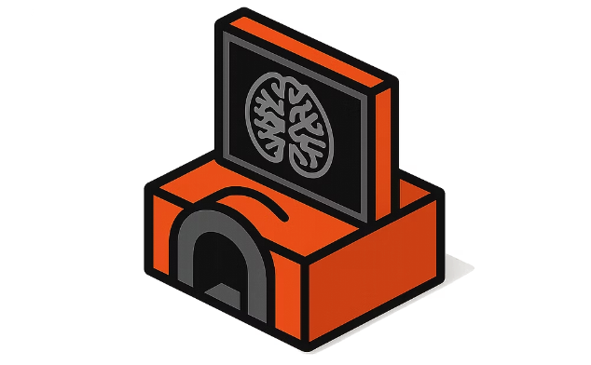
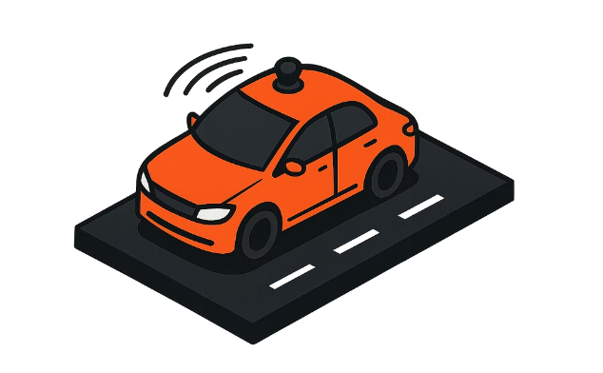
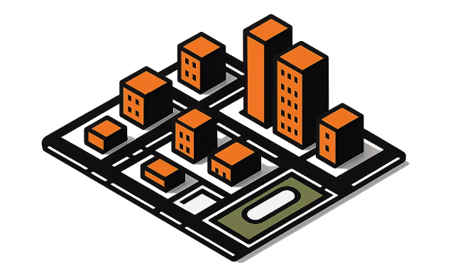
Real-World Applications
Medical Imaging
Autonomous Vehicles
Satellite Imagery
Segment tumors, organs, and tissue boundaries in MRI/CT scans with pixel-perfect accuracy
Identify lanes, pedestrians, vehicles, and obstacles in real-time for safe navigation
Map land use, detect deforestation, monitor agriculture, and analyze urban growth

Slide 7
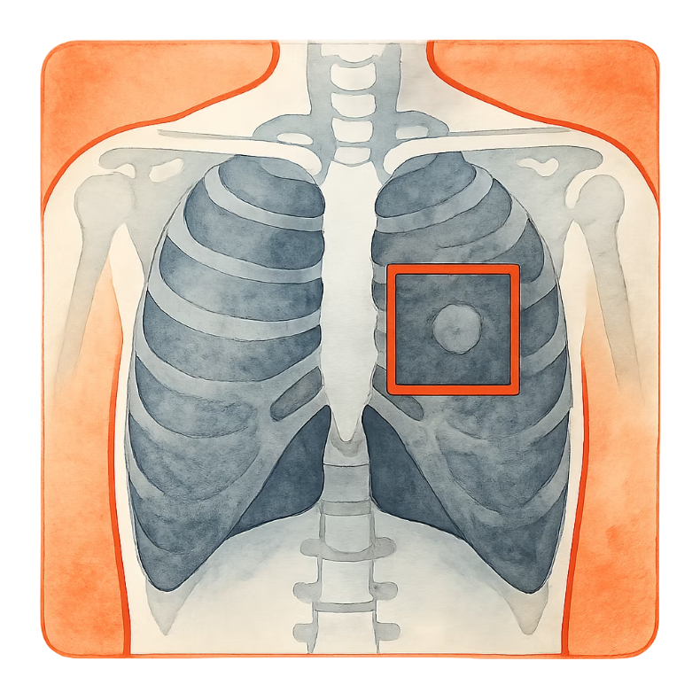
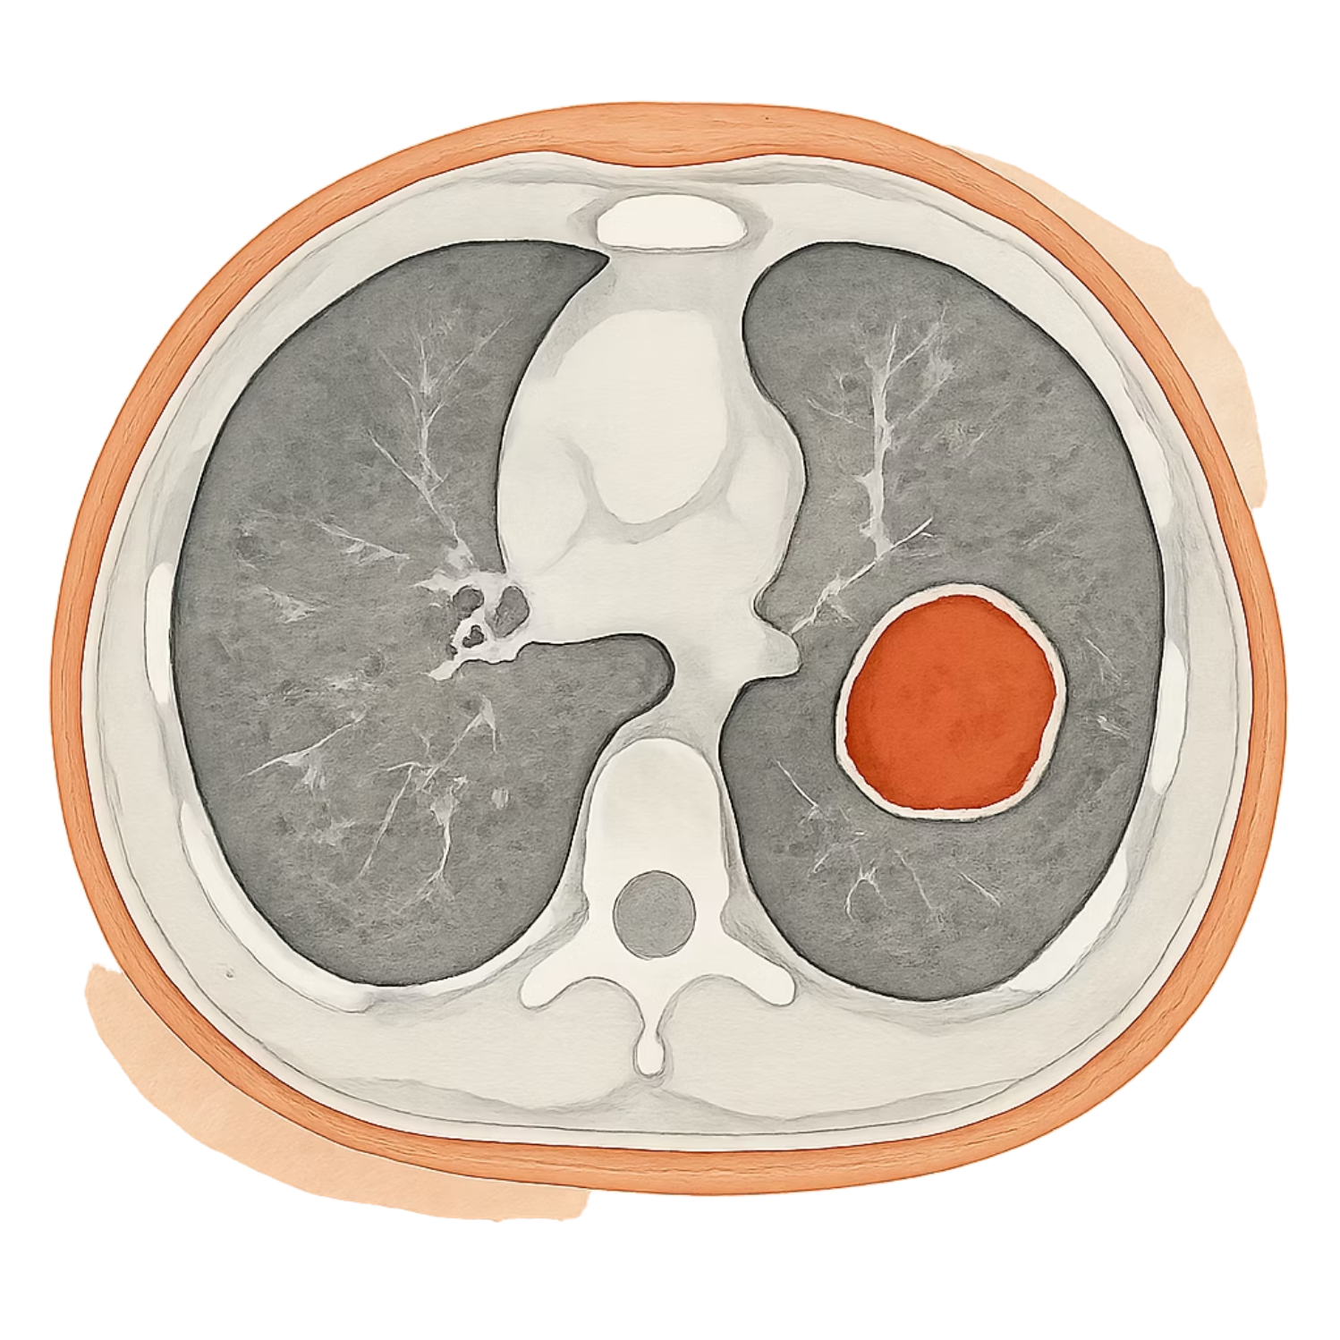
Classification vs Detection vs Segmentation
Image Classification
Output: Tumor / No Tumor
Tells: Whether tumor exists
Limitation: No location
Object Detection
Output: Bounding Box
Tells: Where tumor is
Limitation: Not exact shape
Semantic Segmentation
Output: Pixel Mask
Tells: Exact shape & size
Advantage: Most precise
Object Detection — Bounding box localizes the tumor region
Semantic Segmentation — Pixel mask captures exact tumor boundary

Slide 8
Fully Convolutional Networks (FCN)
Introduced by Long et al. (2015), FCNs were the first end-to-end deep learning approach for semantic segmentation. The key innovation: replace all fully connected layers with convolutional layers, allowing the network to accept arbitrary image sizes and produce spatial output maps.
No Fully Connected Layers
Full Image Processing
Dense Pixel Output
Every layer is convolutional — spatial information is preserved throughout
Operates on the entire image in one forward pass — efficient and scalable
Produces a class score map at each pixel position, not a single class vector
Why “Fully Convolutional”?
In a normal CNN: The last layers are fully connected (dense layers)
These lose spatial information (exact position in image)
In an FCN: No fully connected layers at all. Only convolution layers
This helps preserve spatial structure (where things are in the image)

Slide 9
FCN Architecture
How it works (intuitive):
Encoder (Downsampling): Learns important features (edges, shapes, objects) while reducing image size
Decoder (Upsampling): Restores image to original size and assigns a label to each pixel
Output: Same size as input, but each pixel is classified
In simple terms: first understand the image, then label every pixel.

Slide 10
U-Net: Encoder-Decoder with Skip Connections
Originally designed for biomedical image segmentation by Ronneberger et al. (2015), U-Net introduced a symmetrical architecture and skip connections that have made it one of the most widely used segmentation architectures to this day.
Encoder (Contracting Path)
Skip Connections
Decoder (Expanding Path)
Concatenate encoder feature maps directly to decoder layers — preserving fine spatial detail lost during downsampling
Progressively upsamples while merging context from the encoder, enabling precise localization at the output
Successively applies convolutions and pooling to capture context and build a compressed feature representation

Slide 11
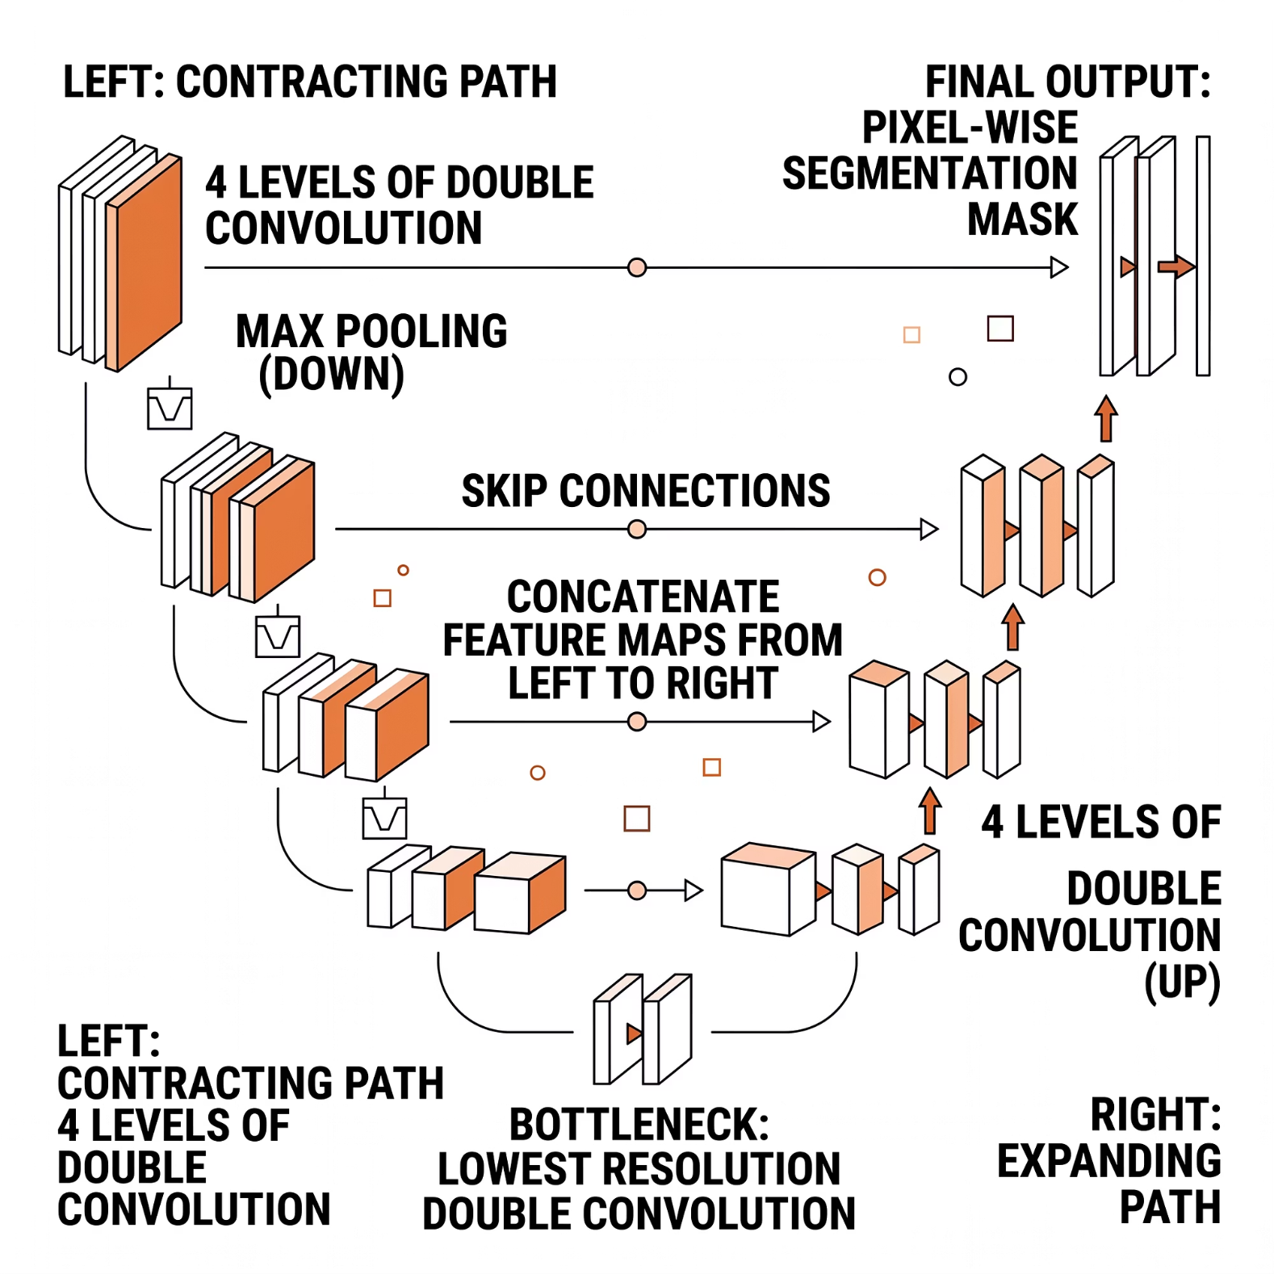


U-Net Architecture Deep Dive
Why U-Net Works So Well
The combination of global context (from the bottleneck) and local detail (from skip connections) allows U-Net to produce sharp, accurate masks even on very small training datasets — a critical property in medical settings where labeled data is scarce.
U-Net can be trained end-to-end from very few annotated images using data augmentation — often just dozens of examples.

Slide 12

FCN vs. U-Net: Side-by-Side
Property
FCN
U-Net
Architecture
Encoder + simple upsampling
Symmetric encoder-decoder
Skip Connections
Limited (coarse)
Dense (every level)
Output Sharpness
Moderate
High — fine boundary detail
Best For
General scene parsing
Medical & small-dataset tasks
Data Requirements
Large datasets preferred
Effective on small datasets
Both architectures share the same fundamental principle: encode features, then decode to a pixel-level prediction. The difference is in how much spatial information is preserved along the way.

Slide 13
Training Data: The Labeling Challenge
Labels are the bottleneck.
Unlike image classification — where crowd-sourced labels are easy to collect — semantic segmentation requires precise pixel-level masks drawn by domain experts. A single medical scan can take hours to annotate correctly.
Time-Consuming
Expensive
Each image may require 30–90 minutes of expert annotation time
Domain expertise (e.g., radiologists) multiplies cost significantly
Imbalanced Classes
Background pixels vastly outnumber foreground — causing training instability

Slide 14
Core Challenges in Semantic Segmentation
1
Pixel Labeling at Scale
2
Class Imbalance
3
Computational Cost
Generating high-quality training masks is slow, costly, and requires expert knowledge — especially in specialized domains like pathology or satellite analysis.
In most scenes, background pixels dominate. Without careful loss weighting (e.g., Dice loss, focal loss), models underfit rare but critical classes.
Dense prediction over full-resolution images demands significant GPU memory. Real-time deployment (e.g., autonomous vehicles) adds strict latency constraints.

Slide 15
The Case for Pre-Trained Models
Labeling is expensive. Data is scarce. Training from scratch is costly. Transfer learning addresses all three.
The Cold-Start Problem
Save Time & Resources
Work with Small Data
Training a segmentation model from scratch requires large annotated datasets and significant compute budgets — resources most teams don't have. Pre-trained models sidestep this barrier entirely.
Skip millions of training steps already learned on large-scale datasets like ImageNet or COCO
Fine-tune on as few as a few hundred labeled images and still achieve strong performance
Better Accuracy
Pre-trained feature extractors generalize better than randomly initialized weights

Slide 16
Widely Used Pre-Trained Models
FCN-ResNet50
DeepLabV3+
Classic FCN backbone using ResNet-50. Strong general-purpose baseline. Available natively in PyTorch's torchvision.
Atrous convolutions + ASPP module for multi-scale context. State-of-the-art on PASCAL VOC and Cityscapes benchmarks.
U-Net
Mask R-CNN
The gold standard for biomedical tasks. Pre-trained variants available via MONAI and Hugging Face for direct fine-tuning.
Extends Faster R-CNN with a mask head. Enables instance-level segmentation alongside object detection in one model.

Slide 17

Specialized & Foundation Models
A new generation of large-scale foundation models has emerged — capable of segmenting anything with minimal or zero task-specific training.
Segment Anything Model (SAM)
MedSAM
Domain-Specific Models
SAM fine-tuned on over one million medical image-mask pairs. Outperforms generic models on clinical segmentation tasks including CT, MRI, and ultrasound.
Agriculture, geospatial, pathology — specialized models fine-tuned on domain-specific datasets offer best-in-class performance for narrow tasks.
Meta AI's zero-shot segmentation foundation model. Accepts point, box, or text prompts. Generalizes across virtually any domain without fine-tuning.
Foundation models like SAM represent a paradigm shift: instead of training per-task, a single model can be prompted to segment anything — dramatically lowering the barrier to entry.

Slide 18
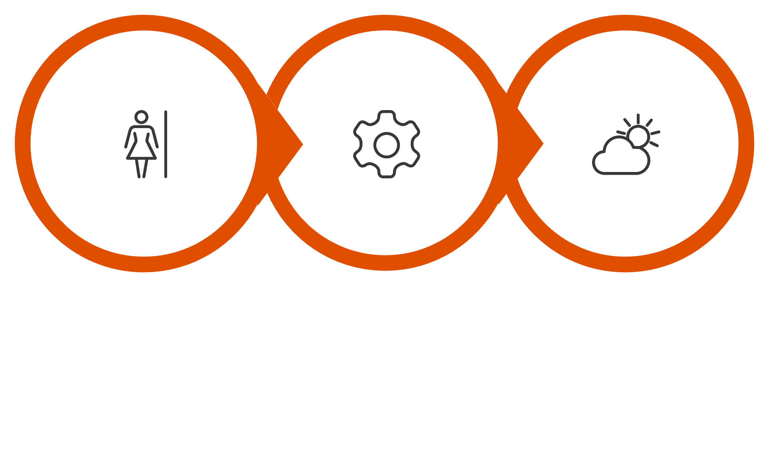
Practical Approach: Getting Started
Pre-Trained Model
Fine-Tune
Deploy
Framework Choices
Where to Focus First
PyTorch: torchvision.models.segmentation for FCN and DeepLabV3. MONAI for medical imaging pipelines.
TensorFlow/Keras: TF Hub hosts ready-to-use DeepLab variants.
Invest heavily in data quality before model complexity. A well-annotated dataset of 500 images fine-tuned on a strong backbone will outperform a complex model trained on noisy labels.

Slide 19
Key Takeaways
Pixel-Level Classification
FCN & U-Net Are Foundational
Semantic segmentation assigns a class to every pixel — the richest form of spatial image understanding in computer vision
FCN established end-to-end pixel prediction; U-Net's skip connections made sharp, data-efficient segmentation possible
Pre-Trained Models Are Essential
Applications Are Wide and Growing
Transfer learning with models like DeepLabV3+ or SAM dramatically reduces data and compute requirements in practice
From autonomous driving to oncology — semantic segmentation is at the core of the most impactful AI systems being deployed today

